Slide 1


Slide 2

Group Leader Name : Gotipamul Bhavana V.
Group Members Name: Boga Sneha S. Kankurti Tasmiya N. Gulbargawale Tabassum R.
Guided by : Mr.Ravindra Gangundi Sir

Slide 3
CONTENTS
Big data
Evolution of Big data
Characteristics Of Big Data
Defination of Hadoop
Components of Hadoop 1.HDFS 2.MapReduce
Characteristics of Hadoop
Requirenment for installing Hadoop
Conclusion

Slide 4
Big data
Big data is term used to suggest huge data sets(several gigabytes/terabytes/petabytes)of data.
The data is so large and complex that it would become difficult to process using traditional data processing applications.
Big data requires a new set of tools,applications and frameworks to process and manage data

Slide 5
Evolution of Big Data
Data has always been around and there has been a need to store,process and manage data since the begining of modern human civilization.
However,the amount of data captured,stored,proceed and managed depends on various factors including the necessity felt by humans for certain information,available tools and technologies needed for making decision based on the data analysis and so on.

Slide 6
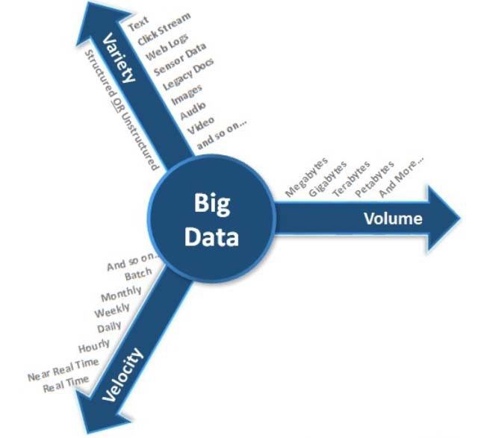
Characteristics Of Big Data
The characteristics of Big Data are popularly known as the three V’s of Big Data.

Slide 7
Volume: Volume refers to the size of the data that the user is working with.Due to advancement of Technology the amount of data that is being generated is growing rapidly.
Variety: Variety refers to different formats in which data is getting generated.
Velocity: Velocity refers to the speed at which data is getting generated.

Slide 8

Hadoop
Hadoop is open source framework .It is capable of processing a large amount of data sets in a distributed fashion.
Hadoop provides a reliable way to store, process & analyze the data.

Slide 9
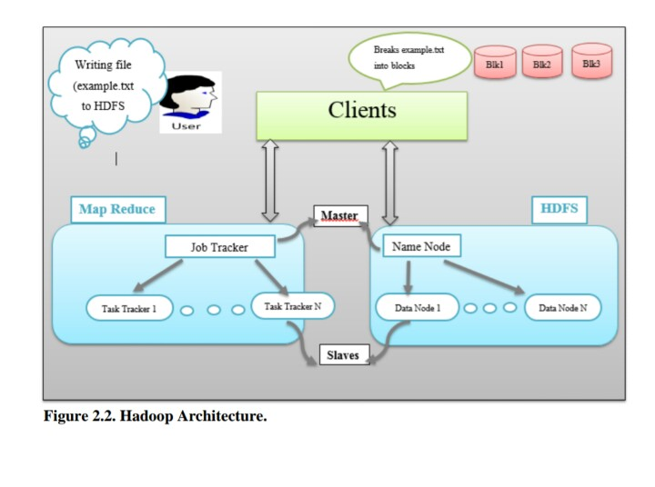

Slide 10
Components of Hadoop
There are two components of Hadoop 1.HDFS 2.MapReduce

Slide 11
1.HDFS
HDFS means Hadoop Distributed File System.
HDFS is capable of storing large amount of data.
HDFS offers a reliable and distributed storage. It replicates the data across multiple nodes
There is no physical location dependancy.

Slide 12
.
HDFS works in a master/slave fasion.
Name Node: master component and holds the information about all other nodes in hadoop cluster.
Data Node:
DataNode is a slave node and hold the user
data .in the form of data blocks. There can be a lot of
DataNodes in hadoop cluster.

Slide 13
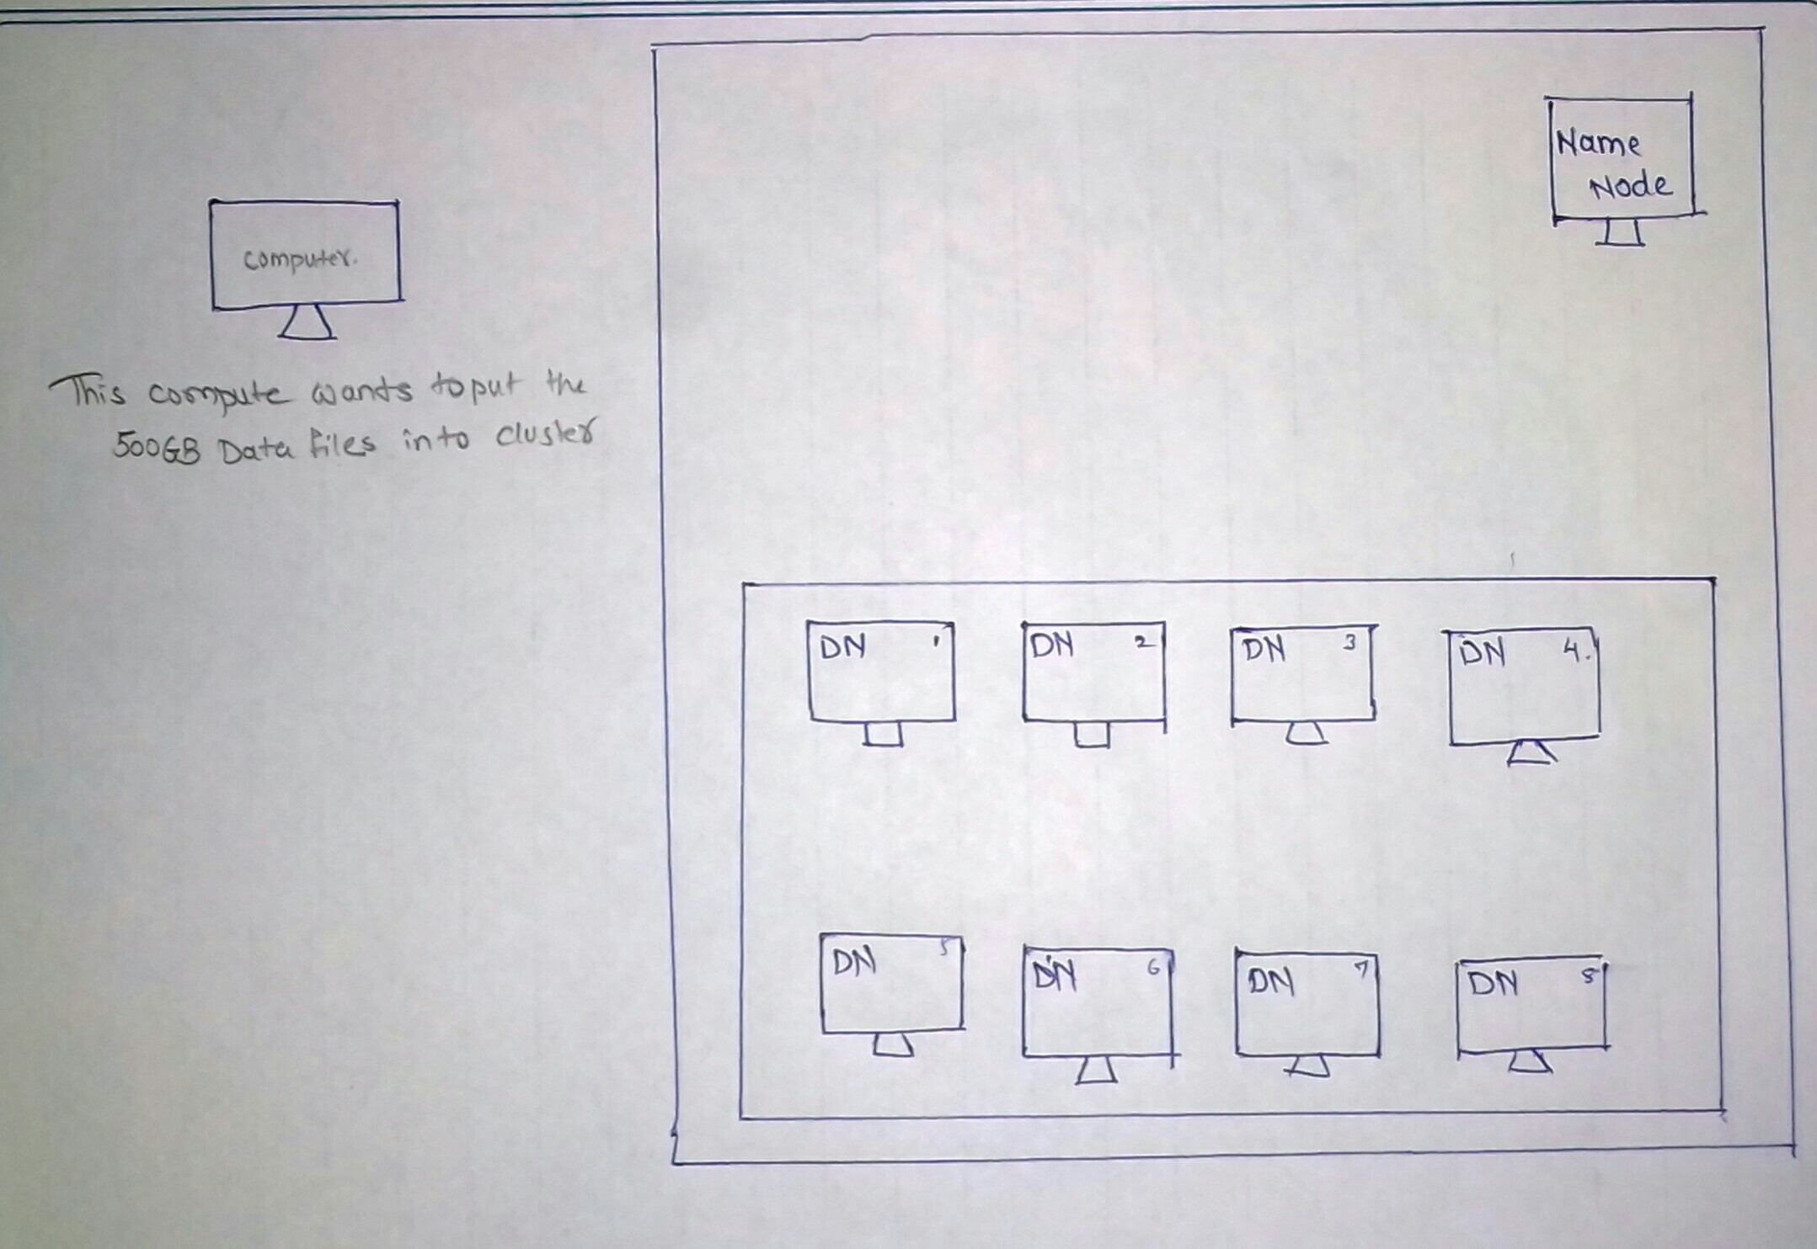

Slide 14
2.MapReduce
It is a programming model for processing large data sets as distributed computing on clusters of computers.

Slide 15
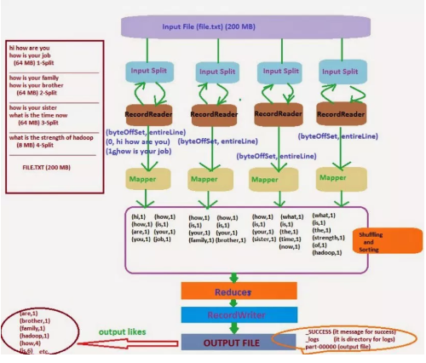

Slide 16
Characteristics of Hadoop
Open source
Scalability
Distributed or parallel processing
Reliability & Availability
Flexibility in data processing
Write once read multiple times

Slide 17
Requirenment For installing Hadoop
4 GB ram
1 TB hard disk
Ubantu operating system

Slide 18
Conclusion
Hadoop is successful solution for Big data Handling
Hadoop expanded from a simple project to the level of platform
The projects and tools on Hadoop are proof for the successfulness of hadoop.

Slide 19
THANK YOU !

